Slide 1
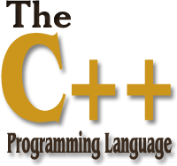
01
02
Lecture 2
04

Slide 2

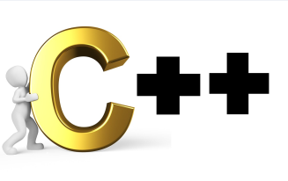
Today’s Agenda
01
Introduction To Object Oriented Programming
02
Problems With Procedure Oriented Progg.
03
What Are Objects In OOP ?
04
How Do We Create An Object ?
05
Syntax Of Creating Class In C++
06
What Are Private And Public In C++ ?

Slide 3

Introduction To OOP
What is Object Oriented Programming ?
. OOP is a programming methodology and is supported by maximum programming
language like C++, Python, Java, JavaScript, PHP, C# etc.
. The world in which we live is full objects. Ever living or non-living thing is
nothing but an object.
. Thus OOP says we should develop our program keeping objects as the center
point.
. Data security is given much more importance.

Slide 4
What Is POP
What is Procedure Oriented Programming ?
. POP is a programming methodology supported by C programming
language.
. The word procedure means FUNCTION and so the term PROCEDURE ORIENTED
PROGRAMMING means Function Oriented Programming.
. In other words it means that we should break our program into multiple
Functions and define each function independently and call it from other parts
of the program as and when the requirement arises.
It means that we sjhplid and define e

Slide 5
Advantages Of POP
Advantages of POP ?
It’s easy to implement
The ability to re-use the same code at different places in the program without copying it.
An easier way to keep track of program flow for small codes
Needs less memory.

Slide 6
Disadvantages Of POP
Disadvantages Of Procedure Oriented Programming
Very difficult to relate with real world objects.
Data is exposed to whole program, so no security for data.
Difficult to create new data types
Importance is given to the operation on data rather than the data.

Slide 7
What is an Object In OOP
In programming any real world entity which has specific attributes or features
can be represented as an object.
In simple words, an object is something that possess some characteristics and
can perform certain functions.

Slide 8
What is an Object In OOP
What does an Object Contain ?
Every Objects is composed of JUST 2 things:
1. Data/Information: represents the values object contain.
2. Functions/Actions: represents the behaviours of an object can perform.
.

Slide 9
What is an Object In OOP
For example, car is an object and can perform functions like start, stop, drive
and brake.
These are the functions or behaviours of a car.
And the characteristics or attributes are color of car, mileage, maximum speed,
model , year etc
.

Slide 10
CLASSES
Now to create/represent objects we first have to write all their attributes and
behaviours under a single group .
This group is called a class .
Thus a class is an architecture/blueprint of the object. It is a proper
description of the attributes and methods of the object.
.

Slide 11
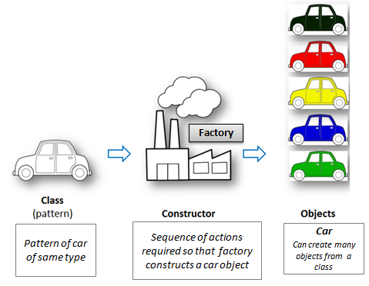
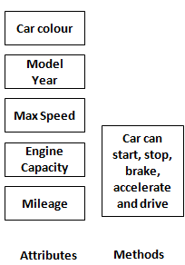
CLASSES
.
For Example:- The design of a car of same type is a class. We can create many objects from a class. Just like we can make many cars of the same type from a design of car.

Slide 12
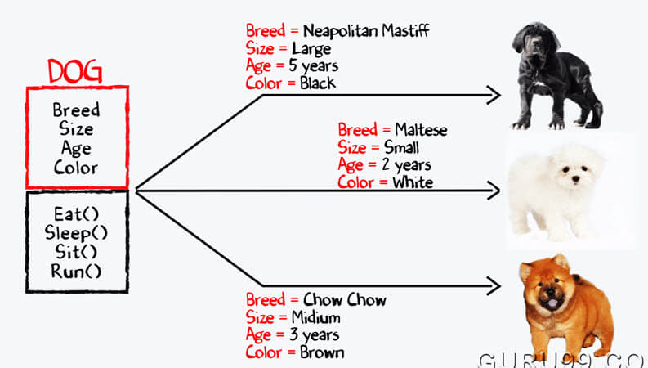
A Dog Class
.

Slide 13
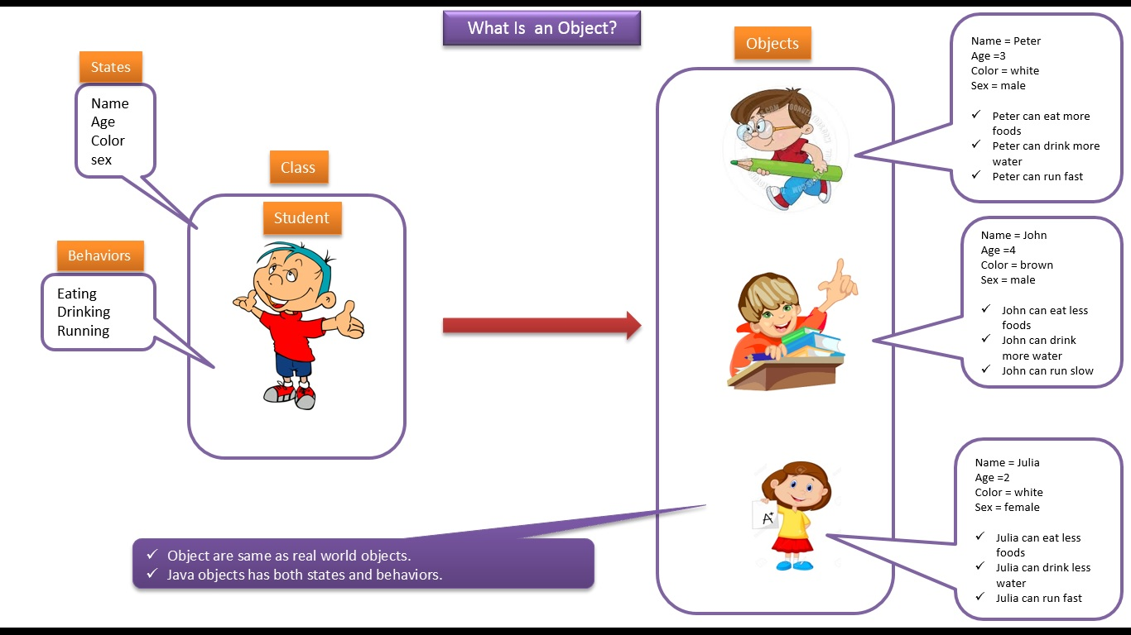
A Student Class
.

Slide 14
General Syntax Of Class
.
Syntax 1:
class <class_name>
{
//data members
public
//member functions
};
Syntax 2 :
class <class_name>
{
//data members
public
//member functions
};

Slide 15
Structure In C & Class In C++
.
Structure “C”
Struct Student
{
int roll;
char grade;
float per;
}
void main()
{
Struct Student S;
S.roll=10;
---
---
}
Class “C++” :
class Student
{
int roll;
char grade;
float per;
void get();
void show();
};
int main()
{ Student S;
S.roll=10;
---- };
Data Members
Member Function
Object

Slide 16
What Are Private And Public In C++ ?
.
Private and Public:
Private and Public are keywords.
These keywords are popularly called as access specifiers or visibility modes.
They control that what members of the class will be accessible from outside the class
and what members could not be accessed from outside the class.
The members which are declared as public can be accessed from outside the class, but
the members which are declared as private can never be accessed from outside the class.

Slide 17
What Are Private And Public In C++ ?
.
Normally we always declare data members of the class as private while member
function as public.
In C++ , whenever we design a class by default everything is private, so there is no need
to mention the keyword private. But to make members public we will have use the
keyword Public.
There is one more keyword in C++ which is also called as access specifier and this
Keyword is protected. But discussion about it will only make sense when we discuss
the chapter INHERITANCE.

Slide 18
End of Lecture 2
For any queries mail us @: scalive4u@gmail.com
Call us @ : 0755-4271659, 7879165533
Thank you

